Slide 1


Crisis-level Incident Response for Cigna
Advancing cyber resilience through KPMG cyber framework
Restrictions on disclosure and use of data: The data in this proposal contains trade secrets and confidential or proprietary information of KPMG, the disclosure of which would provide a competitive advantage to others. Therefore, this document shall not be disclosed, used or duplicated, in whole or in part, for any purpose other than to evaluate KPMG’s services described in this proposal. The proposal set out in this document are in all respects subject to the negotiation, agreement and signing of an engagement letter between us. This proposal is subject to clearances of internal risk processes.

Slide 2










KPMG LLP
Suite 12000
1801 K Street, NW Washington DC 20006
Telephone Fax kpmg.com
+1 202 533 3000
+1 202 533 8500
Our promise to you
May 24, 2023
Ms. Kellie Hays
Cigna Global Procurement & Third-Party Management Cigna
Bloomfield, Connecticut United States of America
We know how your business works.
Dear Kellie,
As The Cigna Companies (“Cigna”) seeks a qualified vendor to provide cyber security services, KPMG stands ready to help guide you through the nuances of the services. KPMG will deliver the right combination of experience, resources, and approach to help you identify and procure a modernized process that will provide the efficiency and accuracy Cigna seeks. Our in-depth knowledge of cyber security services strongly positions KPMG to provide high-quality services and deliverables to meet the needs of Cigna.
Cigna and KPMG share a long-standing, valued relationship: KPMG has consistently over-delivered value to Cigna on some of the organization’s most important and strategic initiatives, including Project Dawn Transformation, Finance and Accounting Services, Finance Cloud Enablement, and Client Service Transformation among various others.
We have done this before: We have significant experience developing comprehensive crisis-level Incident Response plans and playbooks for leading corporations that operate with global infrastructure. You can be confident that we will leverage our proven methodology which has been delivered in a range of critical manufacturing organizations and aligns with industry better practice. Through this experience we have solutions to tackle the key challenges and pitfalls and understand the approach that is needed to remediate at speed. For example, we know delivering enterprise-wide Incident Response plans, playbooks, and procedures requires effective and sustained business engagement and have tailored our delivery approach to mitigate these challenges.
We will bring a collaborative approach: KPMG was named by Forrester Research as a leader in their most recent Forrester Wave™: Global Cyber Security Consulting Providers report. Given our knowledge of your ways of working we have tailored a collaborative approach which sets you up for long term success. Our focused senior team of industry leading experts will work with you to understand your current gaps, define your updated procedures, and integrate them into your current practices. We will a utilize a small, experienced delivery team to work hand-in-hand with business stakeholders.
In closing, we want to express our confidence that with KPMG, Cigna will receive a high level of reliability, professionalism, and timely service. We are confident that this proposal emphasizes how important your business is to our engagement team and our firm. However, if you have any questions or require further information about any aspect of our proposal, please do not hesitate to contact me at 202-533-3989 or jbarth@kpmg.com.
Yours sincerely,
We deliver results that matter.
We know how to get things done.
We get the best out of technology.
Jordan Barth Managing Director
Lead Engagement Partner
jbarth@kpmg.com
We’re on your side all the way.
© 2023 KPMG LLP, a Delaware limited liability partnership and a member firm of KPMG global organization of independent member firms affiliated with KPMG International Limited, a private English company limited by guarantee. All rights reserved.
2

Slide 3


Table of contents
01 | Our value proposition | 04
02 | Approach | 08
03 | Why KPMG | 12
04 | Your investment | 16
Restriction on Disclosure and Use of Data – This document contains confidential or proprietary information of KPMG LLP, the disclosure of which would provide a competitive advantage to others; therefore, the recipient shall not disclose, use, or duplicate this document, in whole or in part, for any purpose other than recipient's consideration of KPMG LLP's proposal.
This proposal is made by KPMG LLP, a Delaware limited liability partnership and a member firm of the KPMG global organization of independent member firms affiliated with KPMG International Limited, a private English company limited by guarantee, and is in all respects subject to our client and engagement acceptance procedures as well as the execution of a definitive engagement letter or contract. KPMG International Limited provides no client services. No member firm has any authority to obligate or bind KPMG International Limited or any other member firm vis-à-vis third parties, nor does KPMG International Limited have any such authority to obligate or bind any member firm.
© 2023 KPMG LLP, a Delaware limited liability partnership and a member firm of the KPMG global organization of independent member firms affiliated with KPMG International Limited, a private English company limited by guarantee. All rights reserved.
© 2023 KPMG LLP, a Delaware limited liability partnership and a member firm of KPMG global organization of independent member firms
affiliated with KPMG International Limited, a private English company limited by guarantee. All rights reserved.
3

Slide 4
1
Our value proposition

Slide 5


Our understanding
01 | Value proposition
Overall objectives
Your ask:
Cigna is seeking a partner to help review current Cybersecurity Incident Response materials, identify gaps related to crisis-level incidents, and update those materials with crisis-level procedures
Review current cybersecurity crisis and incident response process
Identify gaps with Cigna’s process in handling crisis-level incidents
Cigna is a global firm with multiple subsidiaries and an extensive IT footprint. We understand the challenge that comes with maintaining a complex security infrastructure.
Currently, Cigna feels comfortable with its CSIRT plan as it relates to incidents that aren’t escalated to a crisis level but feels that they could enhance the documentation around the added risk, complexity and urgency that is required for a crisis-level incident.
As a global firm, an incident that is deemed crisis level could involve multiple countries in different time zones with different first responders and various stakeholders throughout the business.
We know from our experience responding to some of largest cybersecurity breaches globally that planning for how to do organize stakeholders that before an incident occurs is crucial in coming to decisions quickly and effectively.
Cigna needs to be able to understand how to escalate to the right stakeholders and what information should be captured for leadership to ensure the crisis remediation can be effective.
KPMG’s extensive experience responding to cybersecurity breaches, as well as our framework for crisis and incident planning can help accelerate Cigna’s efforts to move its program forward.
Bolster documentation with crisis layer response procedures
Review developed material to validate the process and inform stakeholders
© 2023 KPMG LLP, a Delaware limited liability partnership and a member firm of KPMG global organization of independent member firms affiliated with KPMG International Limited, a private English company limited by guarantee. All rights reserved.
Document Classification: KPMG Confidential
5
5

Slide 6





01 | Value proposition
Planning for cyber resilience
KPMG is an industry leader in helping clients prepare for cybersecurity incidents and become more resilient to attacks before they occur. We bring with us our tested and continuously evolving framework for cyber resilience as part of our delivery of crisis-level planning. Some elements of our perspective are as follows:
Driving effective crisis-level management relies on documented and rehearsed coordination between all aspects of the company. Starting with the first responders, proper triage and escalation of details to the correct stakeholders is crucial in conducting efficient response. | Planning for a cyber crisis needs deep experience in executing effective crisis- level response across large organizations and because of our history as a leading incident response firm, we know what it takes to properly plan for it.
Decision makers need sufficient processes and preparation to be ready to understand current and potential impact of a breach, and how to effectively coordinate with all affected parties to make the correct decisions needed to mitigate risk and remediate quickly and efficiently. | Crisis planning requires continually evolving your approach based on how threat actors change their tactics and the rapidly changing industry leading practice. We regularly update our framework as the threat landscape changes.
Planning for a cyber crisis needs to consider the organization’s culture, IT landscape, strategic vision and specific threat profile in order to be comprehensive. | Not only do we know what it takes to properly plan for it, we have done it before. We have created effective and tried Incident Response plans, procedures, and playbooks for major health services and global organizations.
© 2023 KPMG LLP, a Delaware limited liability partnership and a member firm of the KPMG global organization of independent member afirffmilisataefdfilwiaittehdKwPiMthGKPInMteGrnIanttieornnaaltLioimnaitleLdi,maitepdri,va private English company limited by guarantee. All rights reserved.
artnership and a member firm of KPMG global organization of independent member firms ₆
ate English company limited by guarantee. All rights reserved.
Document Classification: KPMG Confi

Slide 7


01 | Value proposition
How crisis-level planning fits in
Our approach involves partnering with our clients to align plans and playbooks with the right level of detail and integration into the overall crisis charter as a hierarchy. Crisis-level integration starts at the Global Cybersecurity Incident Response Plan and should integrate into the playbooks in a consistent manner.
Crisis Charter
Non-technical
Global Cybersecurity Incident Response Plan
Increasing levels of detail
Enterprise Ransomware Playbook
Pre-existing
Indicative examples of playbooks:
Insider Threat
Cloud
Active Directory
Technical
In-scope
3rd Party Supplier
Phishing
Malware
© 2023 KPMG LLP, a Delaware limited liability partnership and a member firm of KPMG global organization of independent member firms affiliated with KPMG International Limited, a private English company limited by guarantee. All rights reserved.
7

Slide 8
2
Our approach

Slide 9
Creating crisis-level response readiness
We help develop integrate cyber crisis planning into existing client plans and playbooks using a step approach to plan, identify gaps, uplift documentation, and validate the process. KPMG would welcome the opportunity to further refine the approach and timeline in additional discussions.
02 | Approach
Project management (10 weeks total)
 | Step 1. Step 2. Step 3. Step 4. Project initiation Identify gaps Uplift documentation Validate with stakeholders (2 weeks) (3 weeks) (3 weeks) (2 weeks)
Key Activities | Develop a stakeholder map, a document request list, interview agendas, communications templates as informed by knowledge gained from past and current engagements Understand current pain points and areas of need as identified currently Develop plan to review provided documentation and understand business operating model complete with security response procedures and capabilities | Review the Incident Response plan and response playbooks Conduct workshops with key stakeholders and SMEs to understand the current state of Cigna’s security practices and capabilities to include data sources and contacts that would be utilized for threat detection and incident response use cases Assess Cigna’s current threat detection and response capabilities against KPMG’s resilience framework and industry leading practices Identify any gaps in current documentation that are not currently addressed specifically for crisis-level events | Develop specific procedures and escalations to be added into current documentation that would enhance current vetted processes to be useful in event of a crisis Seamlessly integrate new procedures into current documentation to allow additional functionality of plans and playbooks to be used for crisis-level incidents Identify any gaps in revised material and provide Cigna any recommendations of additional documentation to be created to ensure a comprehensive Incident Response capability | Conduct walkthroughs with key stakeholders and SMEs of the revised documentation to review additional content created from the project Validate with all present parties that the new procedures would be comprehensive and accurate to responding to a crisis-level incident Validate any technical details are accurate to Cigna’s current and future capabilities to ensure the processes can be followed Receive any feedback of changes or additions that could be made to documentation Integrate any feedback into documentation and repeat steps until documentation is validated completely
Deliverables | Document request list Meeting request list Interview agendas Project plan | List of identified gap areas for crisis-level enhancement | Updated IR plan with crisis-level integration Updated playbooks with crisis-level integration Any other relevant CSIRT plan documentation updated to include specifics of crisis-level response | Updates and edits to be made to previous deliverables based on stakeholder feedback Final updated documentation
© 2023 KPMG LLP, a Delaware limited liability partnership and a member firm of KPMG global organization of independent member firms affiliated with KPMG International Limited, a private English company limited by guarantee. All rights reserved.
9

Slide 10
Estimated project timeline
Based on our experience, we developed a notional timeline for the program. The effort needed to identify gaps and update documentation depends on the amount of stakeholder interviews needed and and the number documents that will be revised. We used assumptions based on Cigna’s profile to develop our timeline and are happy to continue to revise collaboratively.
02 | Approach
Week | 1 | 2 | 3 | 4 | 5 | 6 | 7 | 8 | 9 | 10
Project initiation
Identify gaps
Uplift documentation
Validate with stakeholders
© 2023 KPMG LLP, a Delaware limited liability partnership and a member firm of KPMG global organization of independent member firms affiliated with KPMG International Limited, a private English company limited by guarantee. All rights reserved.
10

Slide 11


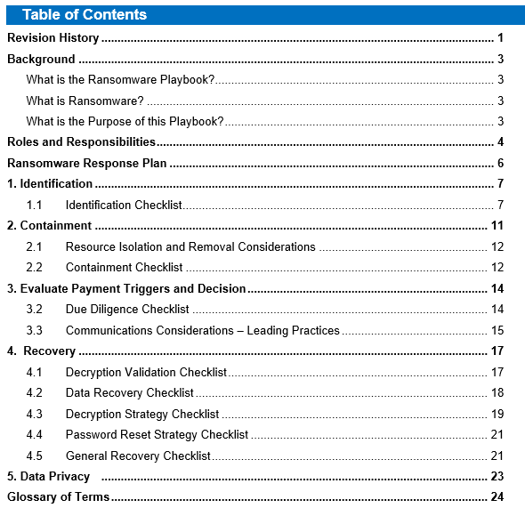
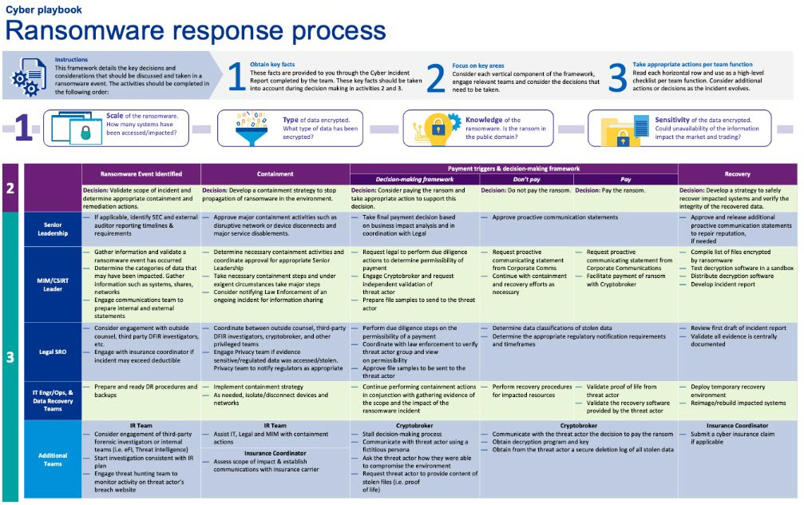

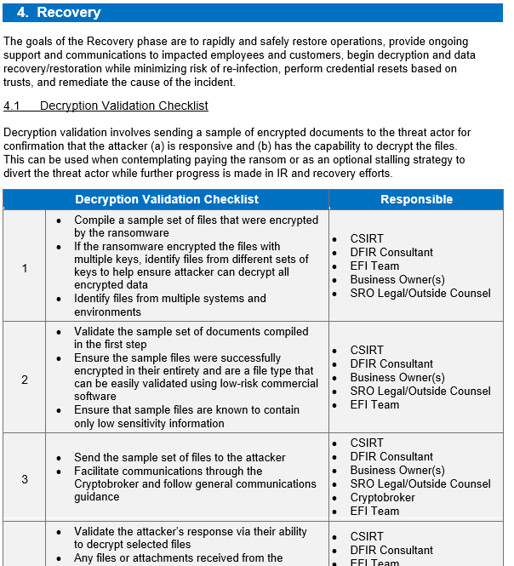
02 | Approach
Example deliverables from our previous work
© 2023 KPMG LLP, a Delaware limited liability partnership and a member firm of KPMG global organization of independent member firms affiliated with KPMG International Limited, a private English company limited by guarantee. All rights reserved.
11

Slide 12
3
Why KPMG

Slide 13

03 | Why KPMG
Why KPMG
1. Global network of cyber resilience professionals
We have a highly capable global team of over 450 resilience experts across the globe. Every resilience consultant at KPMG has access to our extensive global knowledge base, and a network of contacts.
2. We have done this before
Our resilience team has designed and implemented a range of cyber crisis planning assessment and resilience programs.
The team includes people who have delivered end- to-end sustainable global resilience change programs, in complex industries including health services, retail, technology, telecoms and financial services.
We understand that cyber resilience and crisis planning is not standalone and needs to work with the business to successfully identify and manage complex interdependencies with both business functions and other programs, so that change is implemented in a coordinated and manageable way.
3. Resilience approach
Our extensive experience in designing and successfully implementing global strategies and supporting roadmaps has enabled us to develop propriety KPMG resilience maturity models and toolkits.
These enablers will be used to accelerate delivery, provide efficiencies, and help reduce our overall cost of delivery.
Stakeholder management will be prioritised in the development of the roadmap to get buy-in and endorsement from key individuals and business units.
4. Health services expertise
We support many large health services organisations in technical areas such as security and business continuity, which puts us in a position where we clearly understand what benchmarks look like in this sector, together with the expectations of suppliers and service providers.
We can leverage this experience and knowledge to help you navigate your cyber resilience journey to better meet stakeholder expectations.
We are the largest provider of professional services to healthcare and health services companies globally.
5. KPMG know Cigna
KPMG understand Cigna and your expectations. We have supported Cigna since 2008 and have over 25 current engagements with Cigna globally across consulting and tax services.
We have a long history of close collaboration with Cigna, spanning across cyber security, privacy, tax, and finance operations.
© 2023 KPMG LLP, a Delaware limited liability partnership and a member firm of KPMG global organization of independent member firms affiliated with KPMG International Limited, a private English company limited by guarantee. All rights reserved.
13
4

Slide 14


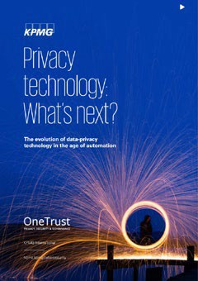

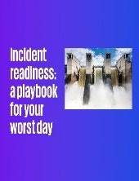


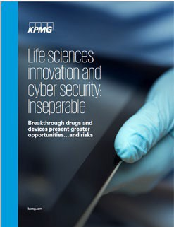

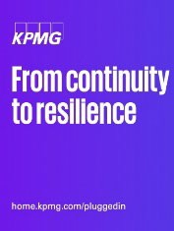



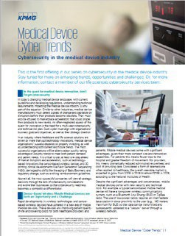
03 | Why KPMG
Thought leadership - KPMG’s cyber & health services
KPMG have provided several thought leadership papers across health services and technology areas, for example:
Privacy technology: What’s next?
Data-privacy technology will need to mature quickly to effectively manage today’s endlessly expanding data universe. In this report, we examine where data-privacy technology and management are going — and needs to go — to effectively respond to a complex and fast- evolving environment.
The time to address medical device cyber security is now
The current state of vulnerable medical devices is unacceptable, requiring an immediate, industrywide call to action. To address ever mounting cybersecurity threats, organisations must take a programmatic approach to identification, mitigation and remediation of risk.
Are you prepared for a cyber incident? In a digital world, where everything is connected, grid shutdowns can bring public services, businesses and homes to a standstill. A robust cyber security culture can significantly reduce the chance of an attack, but organizations should also be ready should an incident occur.
Digitalisation in health services
health services companies are confronted by the twin challenges of reducing costs and enhancing patient outcomes. And all of this in the context of a sweeping wave of digitalization.
Our survey covers digitalization; in other words, the use of digital technologies to modify a business model, enabling revenue and value- producing opportunities.
Build a proactive, resilient organization to ensure continuity of service.
Our growing dependence on electricity makes it more critical than ever to build a proactive, resilient organization to ensure continuity of service. In this article, we take a deeper look at the main drivers of resilience and discuss how companies can integrate these elements to maintain their services
Health services innovation and cyber and privacy: Inseparable
A cyber-security report based on two separate surveys: one for health services organisations, which includes pharmaceutical makers, biopharma and medical device makers, and a second for healthcare payers and providers.
Driving value from genomics
Genomics can bring significant benefits to healthcare by accelerating clinical research and drug development,
personalizing treatment regimens, improving patient outcomes, and reducing the cost of care. Managing this data has led to a change in the way such
information is gathered, stored, analysed and used; with privacy, reliability, and
security posing prickly challenges.
Healthcare 2030
What are the strategic changes which are taking place in healthcare as a result of personalisation and digitisation?
This paper explores some of the strategic decisions that healthcare and health services companies ought to make in terms of organisational structure, focus and customer base.
Medical devices, cyber trends
For the medical device industry as a whole to thrive, each organization must consider its next movements and where to get the most return for its investment dollars.
This paper looks at the cyber risks, threats and trends associated with the medical device industry.
© 2023 KPMG LLP, a Delaware limited liability partnership and a member firm of KPMG global organization of independent member firms affiliated with KPMG International Limited, a private English company limited by guarantee. All rights reserved.
14
25

Slide 15




Our recent health services credentials
03 | Why KPMG
Global pharmaceuticalcompany– BCM and crisis management
Pharmaceuticalscompany– cyber, IAM and risk strategy
Global pharmaceuticalscompany – resilience support
KPMG were tasked with enhancing the business continuity management capability for the finance division of a global pharmaceutical company. They needed to understand their critical processes and how to make them resilient to disruption to a loss of critical function. The client also needed to form an operational crisis management team within the finance division and for the members to be upskilled in their new roles and responsibilities. | KPMG UK cyber team worked with a multinational pharmaceutical company engaging with their cyber, IAM and risk & compliance teams, to deliver their privileged access management (PAM) capability and rolling it out to the business. We also helped them build a view of their future IAM strategy. | The client was interested in assessing its cyber resilience capabilities in response to various types of cyber threats with targeted efforts focused on the integrity and availability of critical information assets.
A current state assessment was first carried out to understand the client’s current level of maturity within business continuity and crisis management. This formed the starting point for the following activities. KPMG worked alongside the financial resilience team to define the critical business processes, before a series of business impact analyses (BIAs) were conducted on their six critical finance processes. As it was a global client, three KPMG member firms were used to conduct simultaneous BIAs and create the resulting business continuity plans (BCPs). KPMG worked closely with the financial resilience team to define their overarching recovery strategy, incident management plan and framework. Roles and responsibilities were defined for this team and a crisis scenario was developed as a training exercise in order for the leads to become familiar with the new roles, responsibilities and documentation. | We developed security and architectural baselines for IAM based on good practice focussing particularly on PAM, authentication, and identity governance and administration. These were to be used to increase re-use of core IAM capabilities, increase supportability, reduce IAM costs, and reduce overall IAM risk levels across the various departments. We supported this client in building a business-led IAM strategy. We engaged with key departments (R&D, manufacturing etc.) to explore their business ambitions and targets and used this information to pull through enterprise and customer IAM requirements. Combining this insight with existing IAM plans from the client’s core technology function, we produced an IAM strategy and multi-year roadmap that supported their vision for the future whilst maintaining the required levels of IAM control, user experience and value for money. | We provided cyber threat actor/vector knowledge based on our previous industry experience and identified relevant threats in collaboration with the client team. Through this we developed a description of the cyber security threat landscape and understanding of the business impact if threats are realized (inherent risk). Attack trees were then generated for each of the agreed cyber threat scenarios and KPMG developed a current state assessment of the client’s DR program to recover from identified cyber threat scenarios. We also developed recovery solution patterns for cyber scenarios, as well as high-level cost and effort estimate for solution patterns, and an implementation roadmap. Which detailed implementation planning and roadmap activities for each of the sites. We also provided leading practices for data protection in IaaS, PaaS, and SaaS applications and assisted with point of contact of DR environment in Azure cloud.
Our work allowed the client to have a clear understanding of their critical business processes and what the minimum requirements are to keep those business functions up and running during a crisis through the BIAs and BCPs. The financial resilience team understood their new roles and responsibilities they would have to take on to successfully manage a crisis and felt more comfortable in making decisions after practicing in the form of table top scenario exercises. | A cost-effective strategy to reduce risk across multiple departments and build a connected IAM solution at an accelerated pace. We were able to work closely with the client’s cyber, IAM and risk & compliance teams to deliver on a multi-year roadmap that would support future plans whilst aligning with required standards. | Our approach focused on areas of high risk and high availabilit therefore the client received noticeable benefits and greater levels of comfort very early on in the engagement. The aim of this work was to build capability, increase awareness and provide the European business continuity coordinator a greater level of oversight in terms of the facilities in operation. This project proved to be a success, and as a result KPMG have continued helping the client with further, more low risk sites.
Client challenge
KPMG
response
y,
Benefits to the client
© 2023 KPMG LLP, a Delaware limited liability partnership and a member firm of KPMG global organization of independent member firms affiliated with KPMG International Limited, a private English company limited by guarantee. All rights reserved.
15

Slide 16
4
Your investment

Slide 17

Fees
4
Your investment
Assumptions
This estimate is provided on the basis of the information currently available and our understanding of your requirements. Furthermore, we’ve used the following assumptions when developing this fee quote:
Based on our understanding of your requirements, KPMG proposes the following fixed fee program:
Step 1 – Project initiation Step 2 – Identify gaps
Step 3 – Uplift documentation
Step 4 – Validate with stakeholders
Total fixed fee for all phases - $285,000.
KPMG will hold 5 to 10 workshops with Cigna stakeholders during the gap identification phase.
KPMG will update the incident response plan and up to 10 playbooks as part of the uplift documentation phase.
KPMG will facilitate three stakeholder validation workshops to help refine the process adjustments and seek additional input.
The project will be conducted collaboratively, whereby representatives will be assigned to work with KPMG engagement team.
KPMG will be given a point of contact to provide relevant documentation, provide feedback on any suggested document additions, and connect them with key stakeholders when additional information is needed.
Eric Goldstrom, Director, is the day-to-day lead for this engagement. Jordan Barth, Managing Director, will bear final responsibility for the engagement and oversee its delivery.
Timing
KPMG is ready to begin work upon receipt of a signed statement work. The activities for each phase will be mutually-agreed upon and can start immediately after project initiation.
© 2023 KPMG LLP, a Delaware limited liability partnership and a member firm of KPMG global organization of independent member firms affiliated with KPMG International Limited, a private English company limited by guarantee. All rights reserved.
17

Slide 18

Jordan Barth
Managing Director, US Cyber Resilience Leader
04 | Your Investment
Professional and industry experience
Jordan is a Managing Director in KPMG’s Cyber Security Services practice with more than 13 years of experience helping clients protect critical assets from cyber threats, improving the ability of companies to detect cyber security incidents and assisting firms in responding to major breaches. He is an accomplished speaker and frequently participates in webcasts, roundtables and panels relating to Cyber Security and Cyber Incident Response. Additionally, Jordan is a vocal advocate for Diversity, Equality and Inclusion within the Cyber Security community and helps lead KPMG efforts around LGTBQ+ inclusion within the workforce.
Jordan leads KPMG’s cyber resilience services across industries to help clients prepare to respond and mitigate ransomware attacks, network intrusions, cloud breaches, intellectual property theft and advanced persistent threats. Additionally, he leads Cloud (Azure/AWS/GCP) incident response automation and orchestration engagements to improve automation in security response.
Jordan has substantial experience leading and coordinating security assessments and remediation projects for security operations centers, performing adversary simulations (purple teaming) as well as incident response readiness and ransomware planning engagements.
Jordan is responsible for leading incident response engagements to confirm and determine scope of cyber-related breaches and discovering the root cause, as well as managing containment and remediation activities. Jordan’s case work has included large ransomware attacks, nation-state espionage and sophisticated network intrusions.
Experiences include:
KPMG LLP
1801 K Street NW Suite 12000
Washington, DC 2006
Tel 202-533-3989
Cell 202-853-8543
jbarth@kpmg.com
Function and specialization
Jordan is a member of KPMG Cyber Services practice specializing in cyber incident response, incident readiness, security operations, adversary simulations and cloud security.
Developed and lead the delivery of KPMG’s cyber resilience framework assessments and planning services across multiple industries globally.
Developed use cases, playbooks and inter-agency processes for security operations center (SOC) incident response operations.
Organized and managed incident response engagement for sector clients to confirm and determine scope of cyber-related breaches and assist the clients in understanding the root cause, perform containment and recover from breaches.
Oversaw and managed investigative steps including forensic collection of evidence, disk and memory-based analysis of evidence and malware, as well as reporting to client leadership and legal departments.
Lead several security operations center (SOC) readiness and effectiveness assessments. Organized and performed reviews and negative testing within Security Incident and Event Management (SIEM) platforms to ensure coverage and detection of security threats..
Designed and performed compromise assessments in complex IT networks using network monitoring tools to find potential compromises needing incident response.
Education, licenses and certifications
PgCert Cyber Security Technology, University of Maryland University College
BS, University of Dayton
Certified Information Systems Security Professional (CISSP)
GIAC Certified Forensic Analyst (GCFA)
GIAC Network Forensic Analyst (GNFA)
© 2023 KPMG LLP, a Delaware limited liability partnership and a member firm of KPMG global organization of independent member firms affiliated with KPMG International Limited, a private English company limited by guarantee. All rights reserved.
18

Slide 19

Eric Goldstrom
04 | Your Investment
SR. MANAGER/DIRECTOR
What can I do for you?
Veteran and former member of the Intelligence Community (IC) with extensive hands-on Information Security operations knowledge combined with practical leadership and management experience.
Documented track record of providing optimal outcomes from high-stakes Fortune 500 breaches. Specializes in leading operational teams, threat intelligence, incident response, malware analysis, red teaming, and threat hunting.
KPMG LLP
1300 SW 5th Ave #3800
Portland, OR 97201
Tel 503-820-6593
Cell 210-238-2562
egoldstrom@kpmg.com
Eric Goldstrom is a Director in the Portland, OR office of KPMG’s U.S. Response Advisory Services practice.
Function and Specialization
Eric specializes in both hybrid and cloud Incident Response. The background in threat intelligence and red teaming provides unique perspectives when helping clients during incidents.
Professional and industry experience
At KPMG, Eric has led ransomware and other high profile breaches. He also conducts proactive services to include Purple Teams, Tabletop Exercises, and Incident Response Program/Plan creation. Eric received his Master’s Degree from Eastern Michigan University in a Cyber Security related path. And he holds several certifications related to both Offensive and Defensive security.
Eric also worked at Mandiant as a Principal Consultant on the Incident Response Team. He worked with several industries to include the Defense Industrial Base (DIB), Financial, Healthcare, Tech, Utilities, and other sectors. The security events Eric helped organizations through were related to SolarWinds, Log4j, Exchange, Ransomware, and more.
Eric began his career in the Department of Defense over 15 years ago. During that timeframe, he worked at the Nation Security Agency (NSA) within the Intelligence Community. Eric conducted numerous Computer Network Exploitation (CNE) operations in order to fulfill critical national level requirements in support of foreign intelligence collection efforts. He also worked as an Incident Response Manager at a Health Tech company. While at this company, he developed a bespoke program called Interactive Threat Defense which focused on Incident Response, Threat Intelligence, and Red Teaming.
Education, Licenses & Certifications
MS, Computer and Information Systems Security, Eastern Michigan University, 2015
BS, Information Systems Security, American Military University, 2014
SANS Class: Enterprise Cloud Forensics and Incident Response, 2021 – Beta
SANS GIAC Python Coder (GPYC), 2019
Offensive Security Certified Professional (OSCP), 2019
AWS Certified Solutions Architect, 2017 (exp)
SANS GIAC Web Application Penetration Tester (GWAPT), 2016
Certified Information Systems Security Professional (CISSP), 2015
SANS GIAC Certified Incident Handler (GCIH), 2012
© 2023 KPMG LLP, a Delaware limited liability partnership and a member firm of KPMG global organization of independent member firms affiliated with KPMG International Limited, a private English company limited by guarantee. All rights reserved.
19

Slide 20



kpmg.com/socialmedia
© 2023 KPMG LLP, a Delaware limited liability partnership and a member firm of KPMG global organization of independent member firms affiliated with KPMG International Limited, a private English company limited by guarantee. All rights reserved.
KPMG name and logo are trademarks used under license by the independent member firms of KPMG global organization.

